Slide 1
ANALYSIS AND UNDERSTANDING ON MOVIE PERFORMANCE: VOTES, RATINGS, REVENUE & GENRE BREAKDOWN
Data Analyzed by:
Name: Stephen Muchai Kimani
Email: Stephen.Muchai@student.moringaschool.com

Slide 2
Business Problem 🔹 Overview
The film industry is highly competitive, with millions spent on production, marketing, and distribution — yet many movies fail to deliver a return on investment. Studios and streaming platforms need deeper insights into the characteristics of high-performing films — both critically and commercially. This project aims to explore historical movie data to identify what makes a film successful.

Slide 3
🔹 Movie Business Pain Points
Unpredictable movie performance: Studios invest heavily without clarity on what drives high ratings or revenue.
Weak alignment between audience preferences and production decisions: Films may achieve high critical acclaim but underperform financially.
Lack of data-driven greenlighting: Decisions about which movies to produce or acquire are often based on instinct or precedent rather than data.
Limited understanding of genre and studio performance trends over time.

Slide 4
🔹 Key Data Questions
Which movies received the highest average ratings and why?
Is there a strong relationship between IMDb ratings and domestic_gross?
What genres tend to generate higher revenue or attract more votes?
How has box office revenue trended over the last 10 years?
Do certain studios consistently produce better-performing films (in terms of revenue and ratings)?
Is there a correlation between number of votes and movie success?

Slide 5
Data Understanding 🔹 Data Sources
The dataset used has combines data from three key sources:
These sources were merged and cleaned.
IMDb Ratings (title.ratings.tsv.gz) Containing average ratings and number of votes for each title.
Box Office Mojo Gross Data (bom.movie_gross.tsv.gz), Providing domestic and foreign box office revenue by title and studio.
IMDb Basics (title.basics.tsv.gz) Including movie titles, genres, runtime, release year, and type.

Slide 6
🔹 Key Variables
Variable | Description | Type
primaryTitle | Movie name | Object
averageRating | IMDb average user rating (0–10 scale) | Float
numVotes | Number of user votes on IMDb | Integer
domestic_gross | U.S. box office revenue | Float
foreign_gross | International box office revenue | Object*
year | Release year | Integer
genres | One or multiple genre tags | Object
studio | Producing or distributing studio | Object
runtimeMinutes | Movie duration | Object*

Slide 7
🔹 Properties of the Main Variables
avarageRating: Continuous, skewed slightly right (most movies fall between 6 and 8).
numVotes: Discrete, long-tailed distribution (few movies get extremely high vote counts).
domestic_gross: Continuous, highly skewed (many low earners, few blockbusters).
Year: Discrete, useful for trend analysis.
genres: Categorical, multi-label

Slide 8
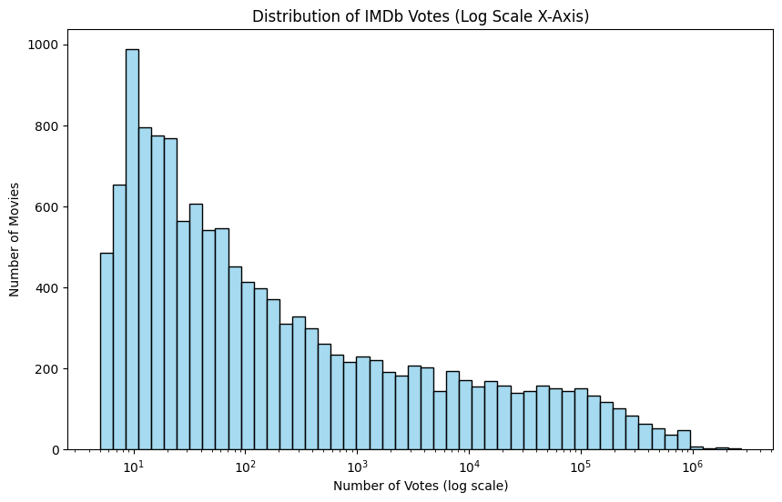
The histogram showing the distribution of IMDb votes across movies

Slide 9
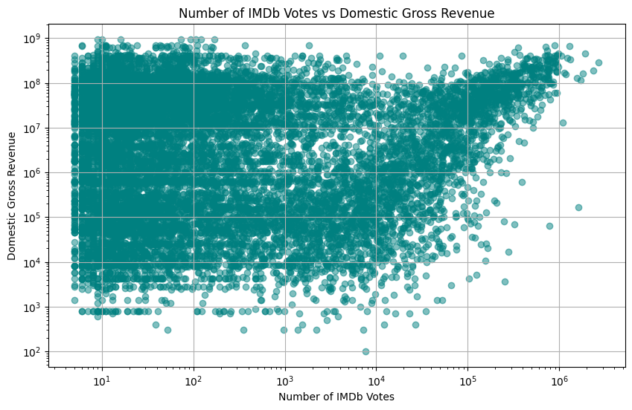
Scatterplot of showing the relationship between Vote with Domestic_gross revenue

Slide 10
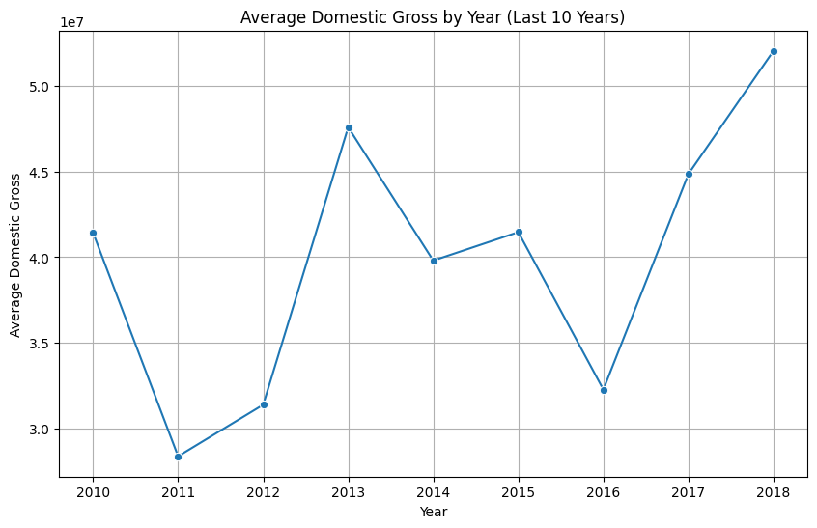
A line plot showing the average domestic gross by year for the last 10 years (2010–2018).

Slide 11
Data Modeling 🔹 Analytical Approach
Exploratory data analysis (EDA) was used as the primary modeling strategy. This includes:
Descriptive Statistics: For understanding central tendencies, variance, and distributions of key metrics such as avaragerating, numVotes and domestic_gross
Correlation Analysis: To see the linear relationships between variables like ratings and revenue.
Visualization Modeling: Histogram, scatterplot, bar chart and line charts were used.

Slide 12
🔹 Modeling Iteration & Improvement
The following steps to refine the analysis:
Data Cleaning: Removed adult titles and non-movie formats, converted runtime, gross, and year to proper numeric types , cleaned and standardized column names for usability.
Outlier Detection: Identified and excluded extreme values where necessary to avoid skewed visuals (e.g., revenue outliers).
Focused Time Window: Limited revenue trend analysis to the last 10 years to reflect recent viewer and market behavior.

Slide 13
🔹 Why EDA Fit the Business Problem
EDA provides clarity without complications because:
Simple visualizations are ideal for stakeholders who may not have a technical background.
Correlation analyses support actionable insights, such as
Which genres are consistently profitable
Do better-rated movies always earn more?
Which studios dominate the high-grossing films?

Slide 14
Evaluation 🔹 Results Analysis
A positive relationship between numVote and domestic_gross that indicate popular movies (more votes) tend to perform better financially.
Certain genres and studios consistently outperform others in terms of ratings or revenue.
Over the last 10 years, there are visible trends in domestic revenue, likely influenced by factors like streaming, franchise dominance, and global releases.

Slide 15
Conclusions 🔹 Key Takeaways
Over 13,000 movie records combining ratings, genres, revenue were analyzed and concluded as below;
Highly-rated movies tend to have strong audience engagement, but ratings alone do not guarantee financial success.
Studios and genres significantly influence box office outcomes, with certain studios consistently outperforming others.
Recent years show a shift in viewer behavior, possibly due to streaming, franchise fatigue, or changing content preferences.

Slide 16
🔹 Recommendations
Based on the analysis, see below recommendations:
Invest in genres and studios that show consistent revenue performance.
Numvote is an early indicator of market interest.
Investigate underperforming genres with high average ratings for potential growth areas
Monitor the coming years , to align with evolving audience behavior.
More focus on foreign gross to gain a more complete global performance view.

Slide 17
🔹 Future Improvements
Streaming data and viewer demographics for more modern, holistic insights.
Benchmarking against the main competitor studios to sharpen strategic decisions.
Conduct series analysis to capture changing consumer patterns and taste over time.
Automate models to forecast revenue and ratings
THANK YOU

